Slide 1




NEXT GEN EMPLOYABILITY PROGRAM
Creating a future-ready workforce
Team Members
College Name
Student Name :Nilesh B
Student ID :au622021104071
Paavai College of Engineering

Slide 2

CAPSTONE PROJECT SHOWCASE
Project Title
Building Bus Reservation System using Python and Django
Abstract | Problem Statement | Project Overview | Proposed Solution | Technology Used | Modelling & Results | Conclusion

Slide 3
Abstract
This project aims to develop a comprehensive Bus Reservation System using Python programming language and Django web framework. The system allows users to efficiently book bus tickets, view available routes, and manage reservations seamlessly. The application employs Django's MVC architecture, incorporating models for data storage, views for user interaction, and templates for rendering dynamic web pages. Key features include user authentication, real-time seat availability updates, payment integration, and an intuitive user interface. By leveraging Python's robustness and Django's flexibility, the proposed system offers a scalable and user-friendly solution for managing bus reservations effectively.
Source :

Slide 4
Problem Statement
The traditional process of booking bus tickets often involves long queues, manual paperwork, and inefficiencies in managing seat availability and reservations. To address these challenges, there is a need for a modern, automated Bus Reservation System that streamlines the booking process, enhances user experience, and improves overall efficiency.
The goal of this project is to develop a Bus Reservation System using Python and Django, which tackles the following key challenges:
1.Manual Booking Process*: Eliminate the need for manual ticket booking processes by providing an online platform where users can easily search for available buses, select seats, and make reservations.
2.Limited Accessibility*: Improve accessibility for users by providing a web-based platform accessible from anywhere with an internet connection, reducing the dependence on physical ticket counters.
3.Inefficient Seat Management*: Implement a system that dynamically updates seat availability in real-time, ensuring accurate information is presented to users and preventing overbooking.
Source :

Slide 5
Project Overview
The current bus reservation systems face several challenges that hinder their efficiency and user experience. These challenges include:
1.Manual Processes: Traditional bus reservation systems rely heavily on manual processes for ticket booking, leading to inefficiencies, errors, and long waiting times for passengers.
2. Limited Accessibility: Physical ticket counters restrict accessibility for passengers, especially those who cannot visit counters due to distance, time constraints, or disabilities.
3. Seat Management Issues: Managing seat availability manually or through outdated systems often results in overbooking, underutilization of bus capacity, and discrepancies in seat allocation.
4. User Experience: Existing systems often lack user-friendly interfaces, making it difficult for passengers to search for routes, check seat availability, and complete bookings seamlessly.
5. Payment Integration Challenges: Integrating secure payment gateways remains a challenge, leading to disruptions in the booking process and concerns about transaction security.
Source :

Slide 6
Proposed Solution
To address the challenges outlined in the problem overview, we propose the development of a modern Bus Reservation System using Python and Django. The solution will offer the following features and functionalities:
User Authentication: Implement user authentication mechanisms to ensure secure access to the system for both passengers and administrators.
2. Booking Management: Develop a user-friendly interface for passengers to search for bus routes, view seat availability, select seats, and make bookings seamlessly.
3. Real-time Seat Availability: Utilize Django's real-time database updates to provide accurate and up-to-date information on seat availability, preventing overbooking and ensuring efficient seat management.
4. Payment Integration: Integrate secure payment gateways such as PayPal, Stripe, or others to facilitate smooth and secure transactions for ticket purchases.
5. Route Management: Implement functionalities for administrators to manage bus routes, schedules, and fares efficiently through an admin dashboard.
.
Source :

Slide 7

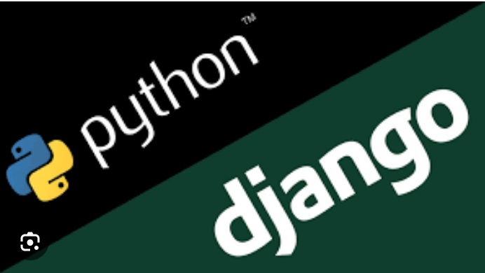
Technology Used
Front-end
Back-end
Source :

Slide 8
Modelling & Results
1.Database Schema Design: Utilize Django's ORM (Object-Relational Mapping) to design a database schema that efficiently stores information about buses, routes, schedules, seat availability, bookings, and user profiles.
2.User Interface Design: Implement a user-friendly interface using Django templates, HTML, CSS, and JavaScript, allowing passengers to easily search for buses, view routes and schedules, select seats, and complete bookings.
Results:
1.Improved Efficiency: The system streamlines the bus reservation process, reducing manual effort and eliminating inefficiencies associated with traditional booking methods
2.Enhanced User Experience: Passengers benefit from a user-friendly interface, real-time updates on seat availability, and seamless payment processing, resulting in a more satisfying booking experience.
3.Increased Accessibility: The web-based platform allows passengers to book tickets from anywhere with an internet connection, enhancing accessibility for users across diverse locations and demographics.
Source :

Slide 9
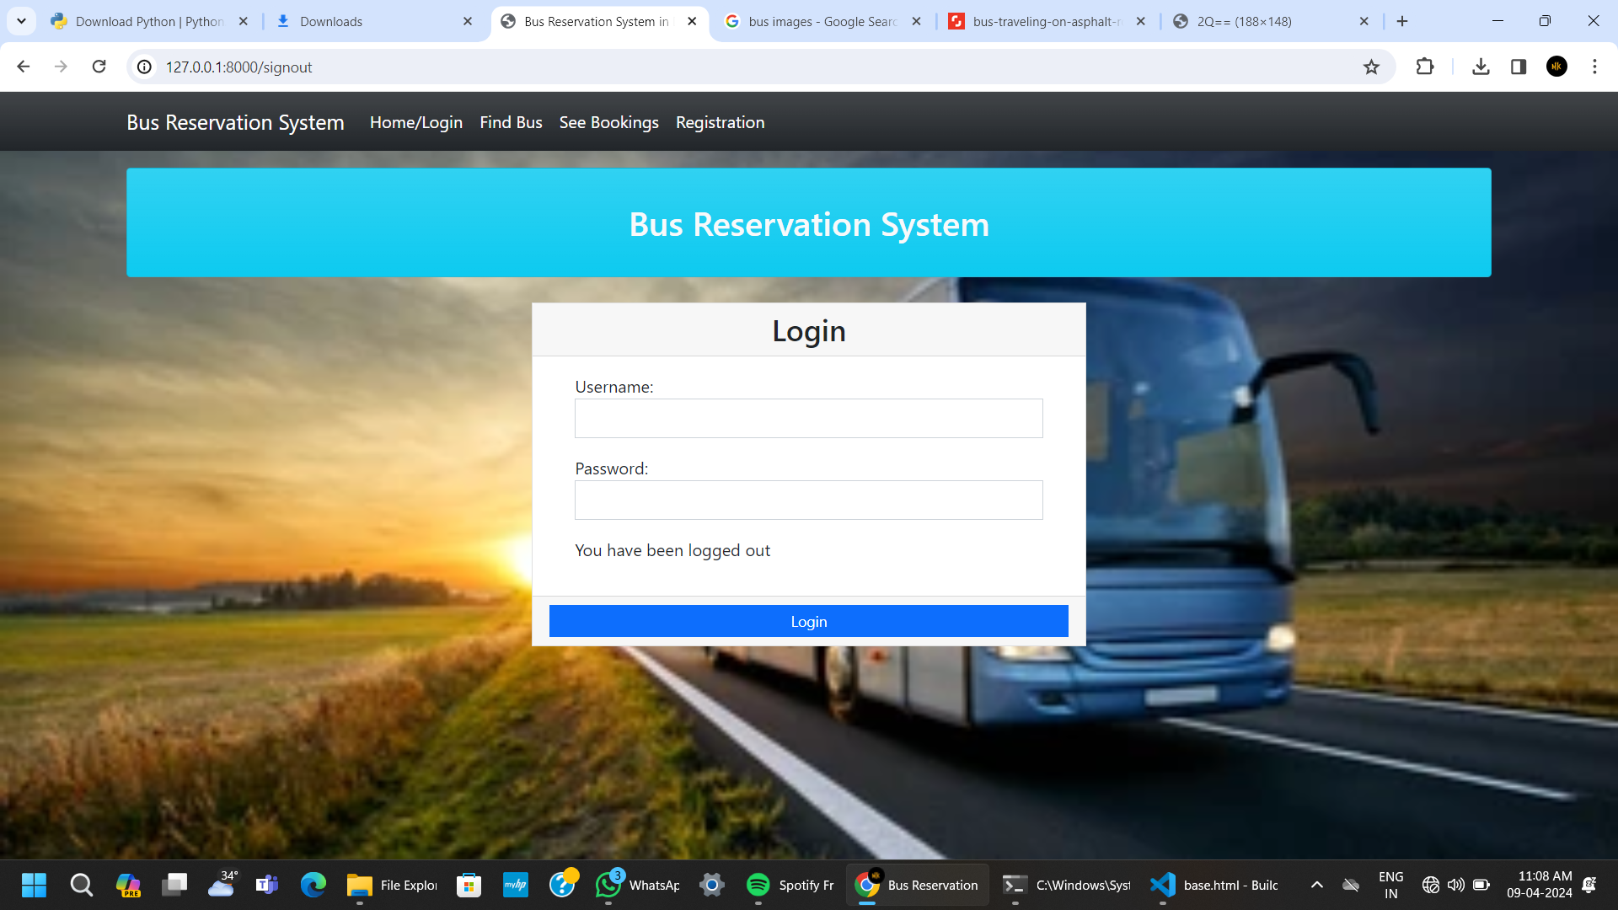
Homepage

Slide 10
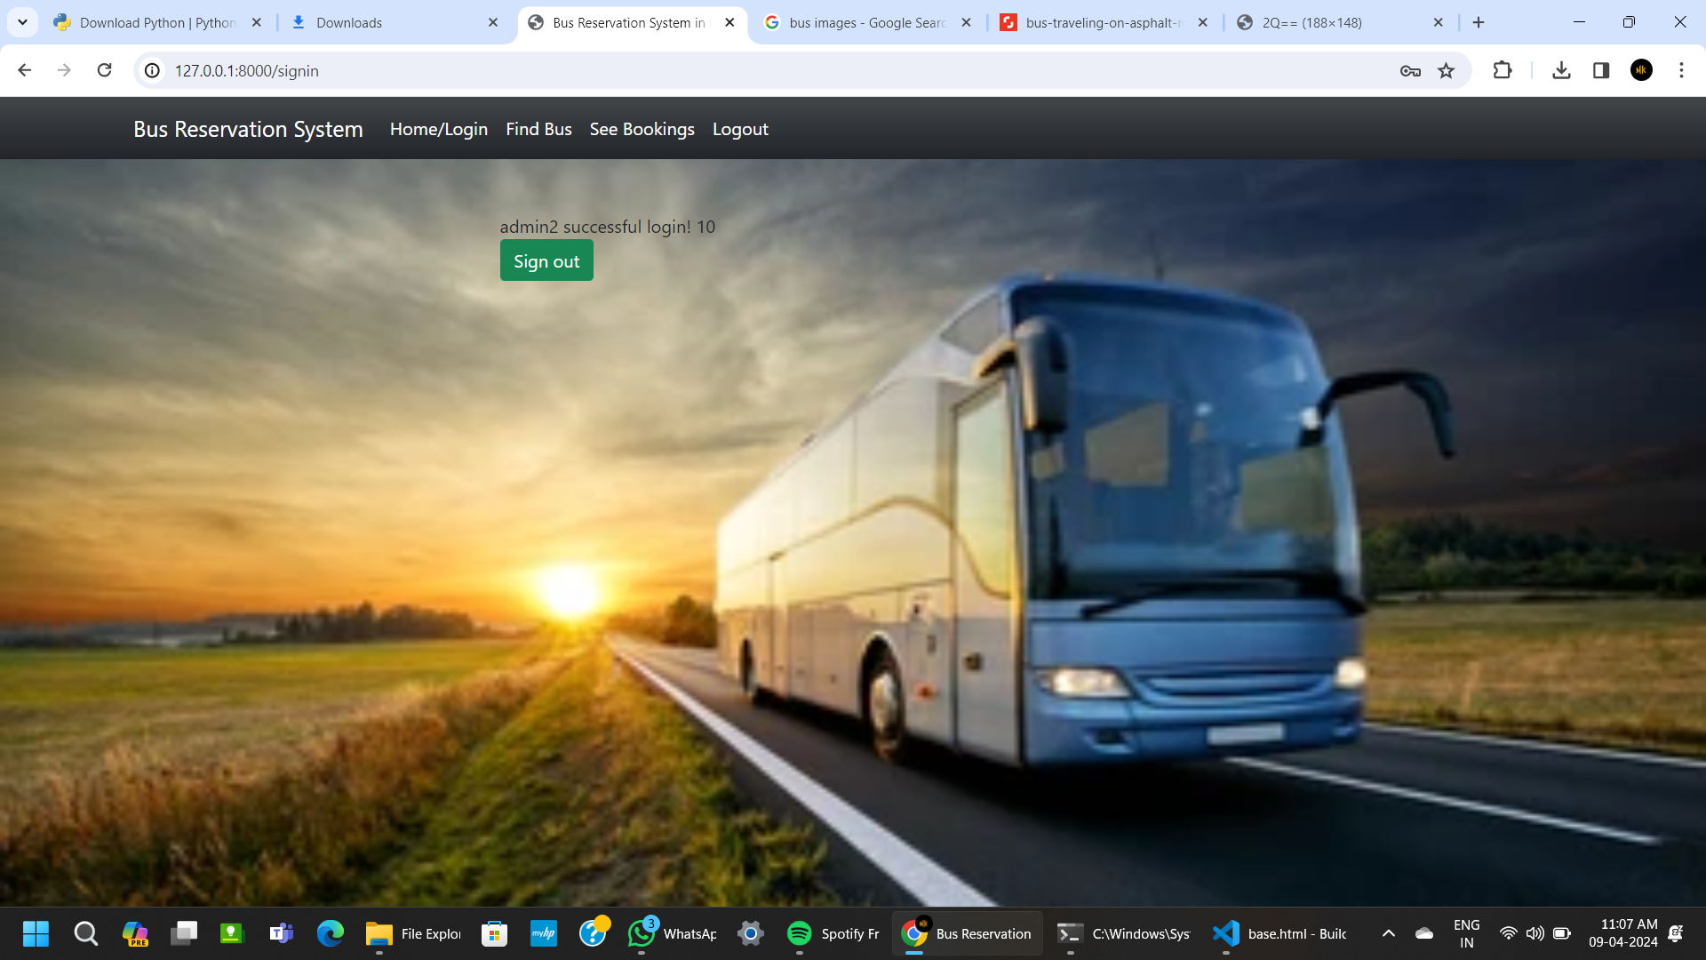
About-Us-Page

Slide 11
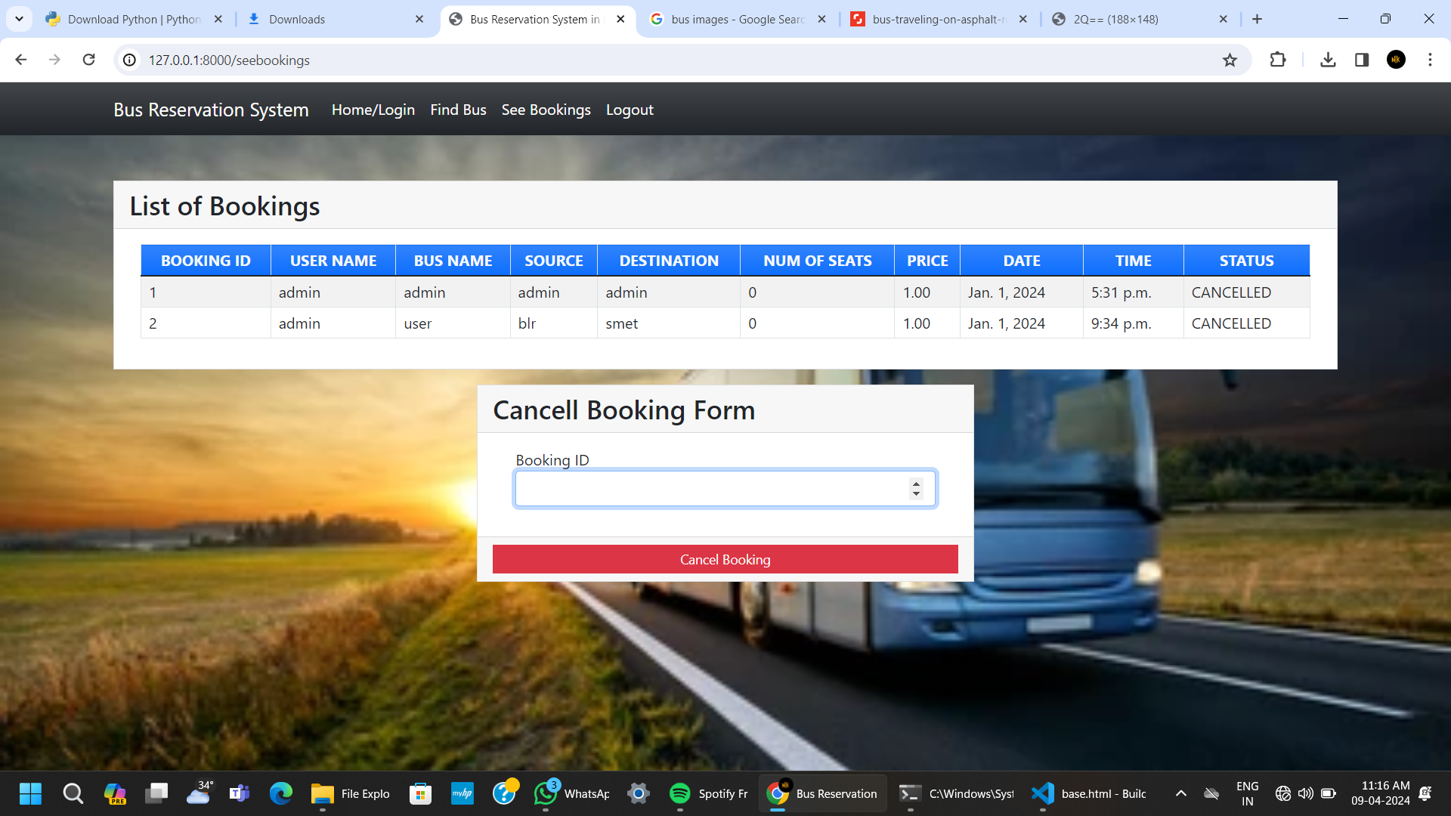
Service-Page

Slide 12
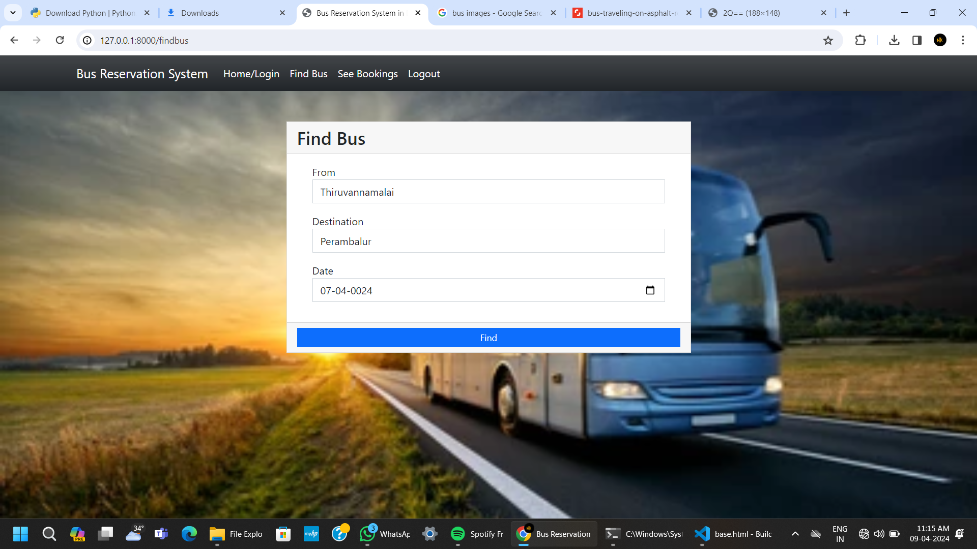
Departments-Page

Slide 13
Future Enhancements:
1.Mobile Application Development: Expand the system's reach by developing a mobile application for iOS and Android platforms, providing passengers with a more convenient way to book tickets on-the-go.
2.Seat Selection: Enhance the seat selection feature by incorporating interactive seat maps, allowing passengers to choose their preferred seats visually and providing additional information such as seat types and amenities.
3.Dynamic Pricing: Implement dynamic pricing algorithms based on factors such as demand, time of booking, and seat availability to optimize revenue generation for bus operators and offer competitive pricing for passengers
4. Integration with External APIs: Integrate with external APIs for additional features such as weather forecasts, traffic updates, nearby attractions, and accommodation options, enriching the overall travel experience for passengers.
5.Multi-language Support: Add support for multiple languages to cater to a diverse range of passengers, enabling users to interact with the system in their preferred language for a more personalized experience

Slide 14
Conclusion
In conclusion, the development of a Bus Reservation System using Python and Django offers a modern and efficient solution to the challenges faced by traditional booking methods. By leveraging the versatility of Python and the robustness of Django, the system provides a user-friendly interface, real-time updates on seat availability, secure payment processing, and efficient management of buses, routes, and bookings.
Through the implementation of features such as user authentication, booking management, admin dashboard, reporting and analytics, and notifications, the system enhances the booking experience for passengers while providing administrators with the tools to manage operations effectively.
Overall, the Bus Reservation System demonstrates significant potential to revolutionize the way bus tickets are booked, making the process more convenient, accessible, and efficient for passengers and bus operators alike. With its scalability, performance, and adaptability, the system stands as a testament to the power of Python and Django in driving innovation and transforming traditional business processes.
Source :

Slide 15
Thank You!
Notes:
Thank You !!

